Slide 1

Let’s Get Ready to Rumble-
The NIST PQC “Competition”
Dustin Moody
Notes:
Rumble – from stomachs
Thank PQCrypto for the time and everything (co-locating)!
Time for Q’s at end…
1. Intro/Background
2. NIST PQC standardization project
3. Submissions
4. What’s next

Slide 2
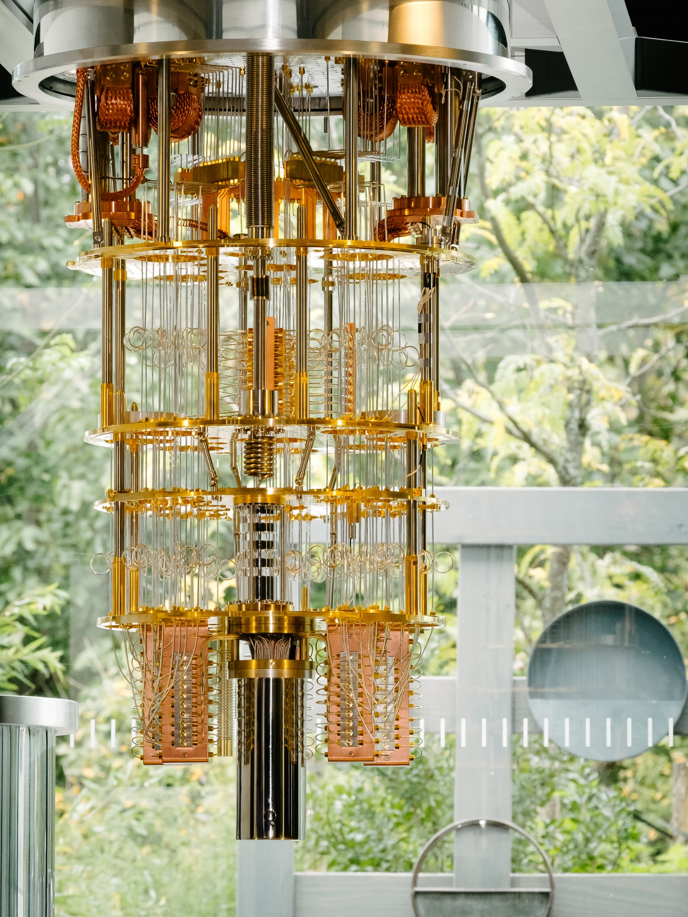
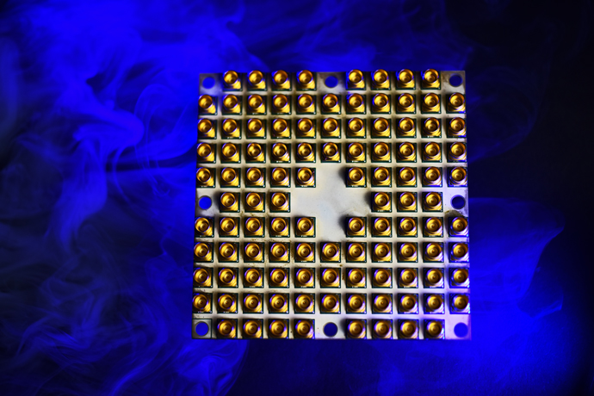
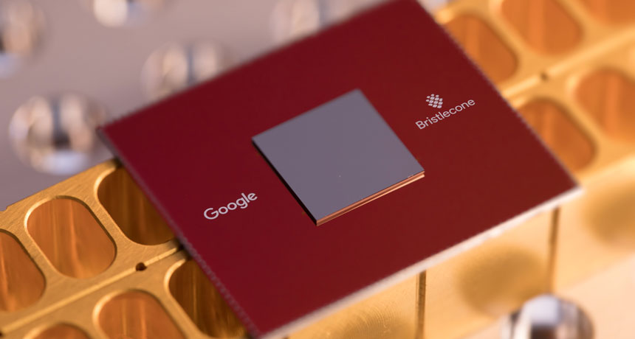
The Rise of Quantum Computing
Intel’s 49-qubit chip
“Tangle-Lake”
January 2018
Google’s 72-qubit chip
“Bristlecone”
March 2018
IBM’s 50-qubit
quantum computer
November 2017

Slide 3
The Impact
NIST Crypto standards
Public key based
Symmetric key based
Guidelines
Signature (FIPS 186)
AES (FIPS 197 )
TDEA (800-67)
Hash usage/security (800-107)
Modes of operations (800 38A-38G)
Transition (800-131A)
Key establishment (800-56A/B/C)
Key generation (800-133)
SHA-1/2 (FIPS 180) and SHA-3 (FIPS 202)
Key management (800-57)
Tools
Randomized hash (800-106)
RNG (800-90A/B/C)
HMAC (FIPS 198)
KDF (800-108, 800-135)
SHA3 derived functions (parallel hashing, KMAC, etc. (800-185)

Slide 4
The Impact
NIST Crypto standards
Public key based
Symmetric key based
Guidelines
Signature (FIPS 186)
AES (FIPS 197 )
TDEA (800-67)
Hash usage/security (800-107)
Modes of operations (800 38A-38G)
Transition (800-131A)
Key establishment (800-56A/B/C)
Key generation (800-133)
SHA-1/2 (FIPS 180) and SHA-3 (FIPS 202)
Key management (800-57)
Tools
Randomized hash (800-106)
RNG (800-90A/B/C)
HMAC (FIPS 198)
KDF (800-108, 800-135)
SHA3 derived functions (parallel hashing, KMAC, etc. (800-185)

Slide 5
The Impact
NIST Crypto standards
Public key based
Symmetric key based
Guidelines
Signature (FIPS 186)
AES (FIPS 197 )
TDEA (800-67)
Hash usage/security (800-107)
Modes of operations (800 38A-38G)
Transition (800-131A)
Key establishment (800-56A/B/C)
Key generation (800-133)
SHA-1/2 (FIPS 180) and SHA-3 (FIPS 202)
Key management (800-57)
Tools
Randomized hash (800-106)
RNG (800-90A/B/C)
HMAC (FIPS 198)
KDF (800-108, 800-135)
SHA3 derived functions (parallel hashing, KMAC, etc. (800-185)

Slide 6
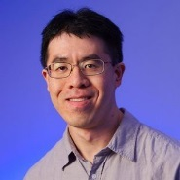

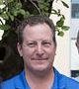





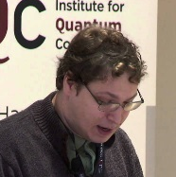

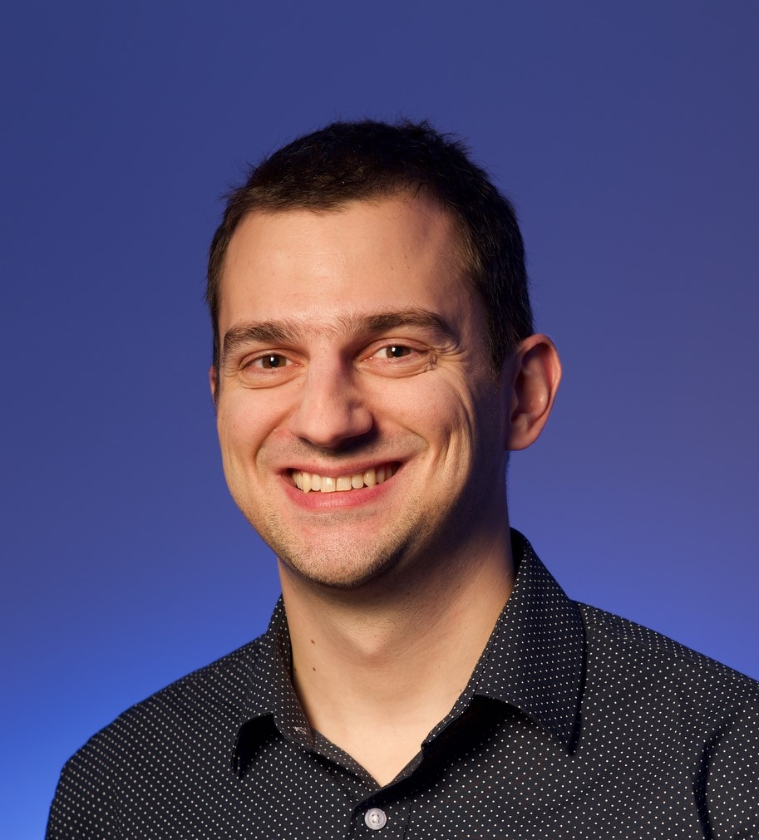
The NIST PQC Project
2009 – NIST publishes a PQC survey
  Quantum Resistant Public Key Cryptography: A Survey [D. Cooper, R. Perlner]
2012 – NIST begins PQC project
  Research and build team
  Work with other standards organizations (ETSI, IETF, ISO/IEC SC 27)
April 2015 – 1st NIST PQC Workshop
Notes:
12+ researchers in crypto, quantum information, quantum algorithms
Bi-weekly seminars. Publish results, attend workshops
Raise awareness for government agencies of coming transition
To monitor progress in quantum computers and quantum algorithms.
To find and standardize quantum-resistant alternatives for PKE, key-agreement, and digital signatures.

Slide 7
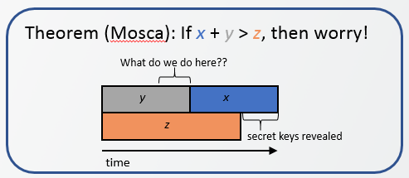
PQC Standardization – when?
There had been much debate about whether it is too early to look into PQC standardization
When will a (large-scale) quantum computer be built?
  “There is a 1 in 7 chance that some fundamental
  public-key crypto will be broken by quantum by
  2026, and a 1 in 2 chance of the same by 2031.”
– Dr. Michele Mosca, (April 2015)
Our experience tells us that we need (at least) several years to develop and deploy PQC standards
Notes:
Like other things at NIST, question of when/if to standardize
Similar estimate from Simon Benjamin (Oxford) at ETSI workshop: 15-25 at current spending, but 6-12 years if Manhattan level spending
Brian LaMacchia has said his company is working with a timetable of around 15 years
DJB has private bet ($2048) on twitter that RSA-2048 will be broken by 2033 (16 years)

Slide 8
The Decision to Move Forward
Aug 2015 – NSA statement
  ... “IAD will initiate a transition to quantum resistant algorithms in the not too distant future ...”
Feb 2016 – NIST Report on PQC (NISTIR 8105)
Feb 2016 – NIST announcement at PQCrypto
We see our role as managing a process of achieving community consensus in a transparent and timely manner
We do not expect to “pick a winner”
Notes:
Certainly lot of interest – 300 people registered
[Lily] if we can make quantum resistant crypto standards, we are all winners.

Slide 9
Timeline
Aug 2016 – Draft submission requirements & evaluation criteria
Dec 2016 – Final requirements and criteria
Nov 2017 – Deadline for submissions
Apr 2018 – NIST PQC Workshop – submitters’ presentations
2018/2019 – 2nd Round begins (smaller number of submissions)
- minor changes allowed
Aug 2019 – 2nd NIST PQC Workshop
2020/2021 - Select algorithms or start a 3rd Round
2022-2024 - Draft standards available
NIST will release reports on progress and selection rationale

Slide 10
Scope
Signatures
  Public-key schemes for generating/verifying signatures (see FIPS 186-4)
Encryption
  Key transport from one party to another
  Exchanging encrypted secret values between two parties to establish shared secret value (see SP 800-56B)
Key-establishment (KEMs)
  Schemes like Diffie-Hellman key exchange (see SP 800-56A)

Slide 11
Differences with past Competitions
Post-quantum cryptography is more complicated than AES/SHA-3
  No silver bullet - each candidate has some disadvantage
  Not enough research on quantum algorithms to ensure confidence for some schemes
We do not expect to select just one algorithm
  Ideally, several algorithms will emerge as “good choices”
We will narrow our focus at some point
  This does not mean algorithms are “out”
Requirements/timeline could potentially change based on developments in the field

Slide 12
Complexities
Much broader scope – three crypto primitives
Both classical and quantum attacks
  Security strength assessment on specific parameter selections
Consider various theoretical security models and practical attacks
  Provably security vs. security against instantiation or implementation related security flaws and pitfalls
Multiple tradeoff factors
  Security, performance, key size, signature size, side-channel resistance countermeasures
Migrations into new and existing applications
  TLS, IKE, code signing, PKI infrastructure, and much more
Not exactly a competition – it is and it isn’t

Slide 13
The Selection Criteria
Security - against both classical and quantum attacks
Performance - measured on various "classical" platforms
Other properties
  Drop-in replacements - Compatibility with existing protocols and networks
  Perfect forward secrecy
  Resistance to side-channel attacks
  Simplicity and flexibility
  Misuse resistance, and
  More

Slide 14
Security Analysis
Security definitions (proofs recommended, but not required)
  IND-CPA/IND-CCA2 for encryption, KEMS
  EUF-CMA for signatures
  Used to judge whether an attack is relevant
Quantum/classical algorithm complexity
  Classical computers may have the cheapest attacks in practice
  Stability of best known attack complexity
  Precise security claim against quantum computation
Quality and quantity of prior cryptanalysis
Notes:
Existential Unforgeability under a. Chosen Message Attack

Slide 15
Quantum Security
No clear consensus on best way to measure quantum attacks
Uncertainties
  The possibility that new quantum algorithms will be discovered, leading to new attacks
  The performance characteristics of future quantum computers, such as their cost, speed and memory size
For PQC standardization, need to specify concrete parameters with security estimates
Notes:
Currently, NIST crypto standards specify parameters for classical security levels at 112, 128, 192, 256 bits

Slide 16
Security Strength Categories
Level | Security Description
I | At least as hard to break as AES128 (exhaustive key search)
II | At least as hard to break as SHA256 (collision search)
III | At least as hard to break as AES192 (exhaustive key search)
IV | At least as hard to break as SHA384 (collision search)
V | At least as hard to break as AES256 (exhaustive key search)
Computational resources should be measured using a variety of metrics
NIST asked submitters to focus on levels 1,2, and 3
  Levels 4 and 5 for high security
These are understood to be preliminary estimates
Notes:
These are understood to be preliminary estimates

Slide 17
Cost and Performance
Standardized post-quantum cryptography will be implemented in “classical” platforms
Ideally, implementable on wide variety of platforms and applications
May need to standardize more than one algorithm for each function to accommodate different application environments
Allowing parallel implementation for improving efficiency is certainly a plus
Preliminary conclusions: efficiency likely OK, but key sizes may pose a significant challenge

Slide 18
Complexities – Part 2
Assess classical security
  Many PQC schemes are relatively new. It’ll take years to understand their classical security. Let alone quantum security.
We need to deal with new situations which we haven’t considered before, e.g.
  Decryption failure
  State management for hash based signatures
  Public-key encryption vs. key-exchange issues
    Public-key encryption IND-CCA2
    Ephemeral key exchange (no key-pair reuse, consider passive attacks, IND-CPA)
  Auxiliary functions/algorithms, e.g.
    Gaussian distribution sampling/simulation
Notes:
Quantum security is just one of the challenges. We need to handle many situations which are new to us. Here are just a few examples. The first is decryption failure. Some encryption algorithms, even you choose everything right, can have failed decryption. It may require a higher level protocol to handle how many decryption failures are allowed before halt. Some hash based signature needs to manage state. Each private key can only use once. The chosen ciphertext model does not apply to one-time key for key establishment. As we work hard on Random number generator for uniformly at random key generation, for some of the post-quantum schemes, we will be Gaussian simulation to generate one time random value.
https://ws680.nist.gov/publication/get_pdf.cfm?pub_id=923190

Slide 19
Intellectual Property
“NIST does not object in principle to algorithms or implementations which may require the use of a patent claim, where technical reasons justify this approach, but will consider any factors which could hinder adoption in the evaluation process.”
  All submitters must declare known patents
  Reminder: submitters turn in your signed IP statements
Submissions (and implementations) are freely available for public review and evaluation
In Round 1, all submissions should be evaluated on their technical merits.
Notes:
Disclaimer: I’m not a lawyer

Slide 20
Submissions
37 preliminary submissions (early deadline Sep 2017)
82 total submissions received
  69 accepted as “complete and proper” (5 since withdrawn)
 | Signatures | KEM/Encryption | Overall
Lattice-based | 5 | 21 | 26
Code-based | 2 | 17 | 19
Multi-variate | 7 | 2 | 9
Symmetric/Hash-based | 3 |  | 3
Other | 2 | 5 | 7
Total | 19 | 45 | 64
Notes:
46 submitted on the last day.
Big thank you to submitters.

Slide 21
Numbers
We have a total of 278 submitters
  67 of those were on more than one submission
    Distribution: [212, 30, 22, 7, 2, 1, 4, 1]
Most submissions cover security levels 1,3, and 5.
  10 submissions target only the lower levels 1,2,3
    CFPKM, CompactLWE, Emblem/R.Emblem, NTRU-HRSS-KEM, PQRSA Enc/Sig, QC MDPC-KEM, Gravity-SPHINCS, HiMQ-3, RaCoSS
  6 submissions target only the high security levels 4,5
    Classic McEliece, GuessAgain, Hila5, Mersenne-756839, NTRUprime, KCL
Notes:
Gaborit is the dude with 8!

Slide 22
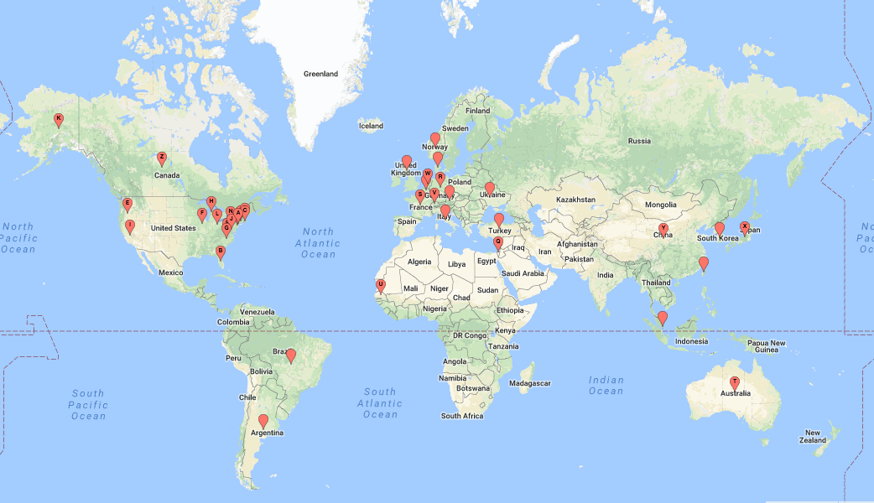
25 Countries, 16 States, 6 Continents

Slide 23
Key Sizes & Performance Graphs
Reminder: “It is important to note that performance considerations will NOT play a major role in the early portion of the evaluation process.”
Disclaimer – These are from the optimized implementations submitted to us. We know better implementations exist/will exist.
These charts should mainly be used to see general patterns
  While performance will vary with implementations, key sizes won’t

Slide 24
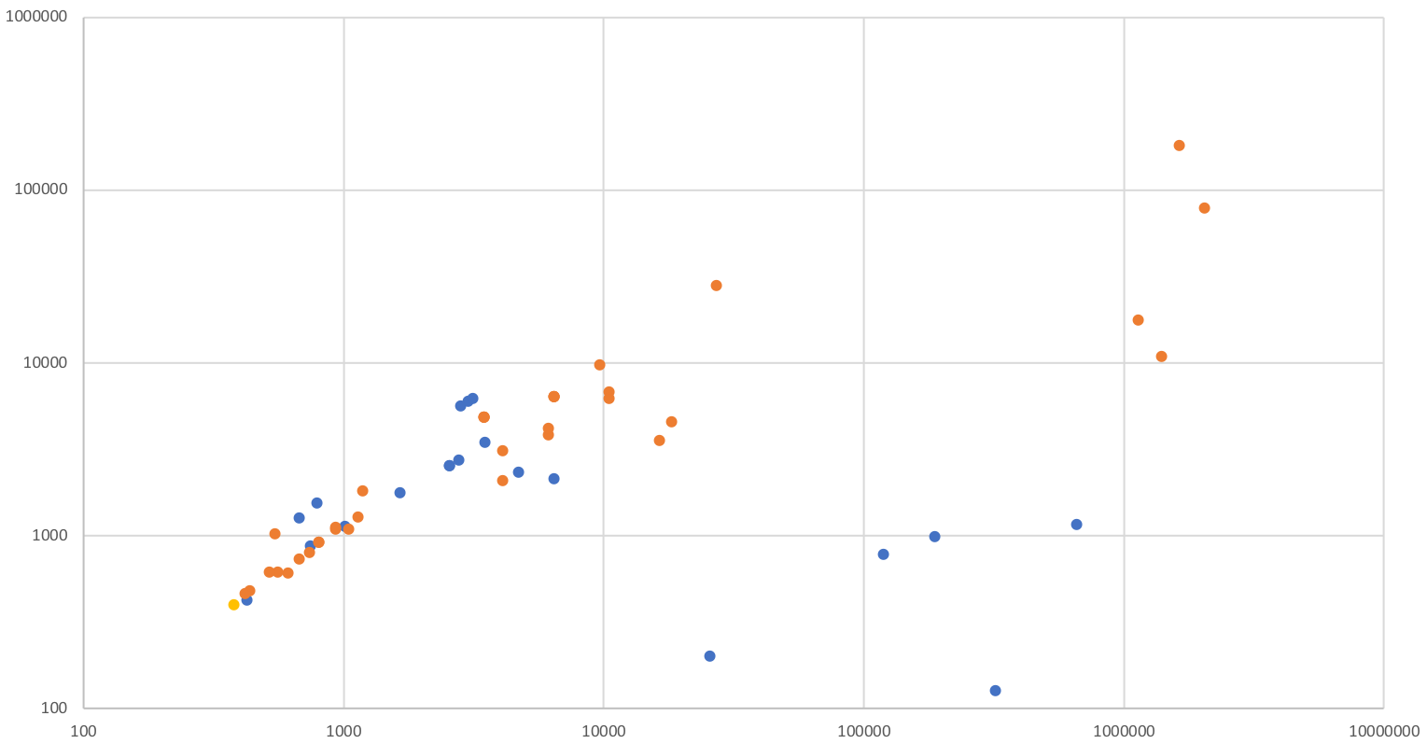
KEM/Encryption (Category 1)
Ciphertext Size (bytes)
Lattice Codes Other
Public Key Size (bytes)
Notes:
Don’t pay attention to individual schemes – just broad patterns

Slide 25
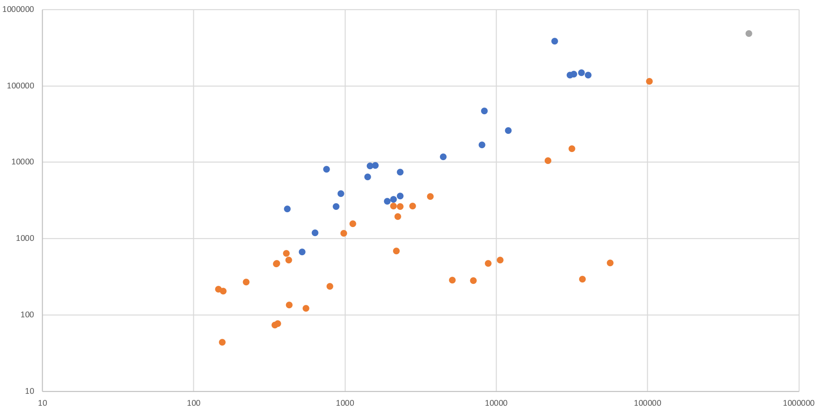
KEM/Encryption (Category 3) Performance
Dec Time (1000s of cycles)
Lattice Codes Other
Enc Time (1000s of cycles)

Slide 26
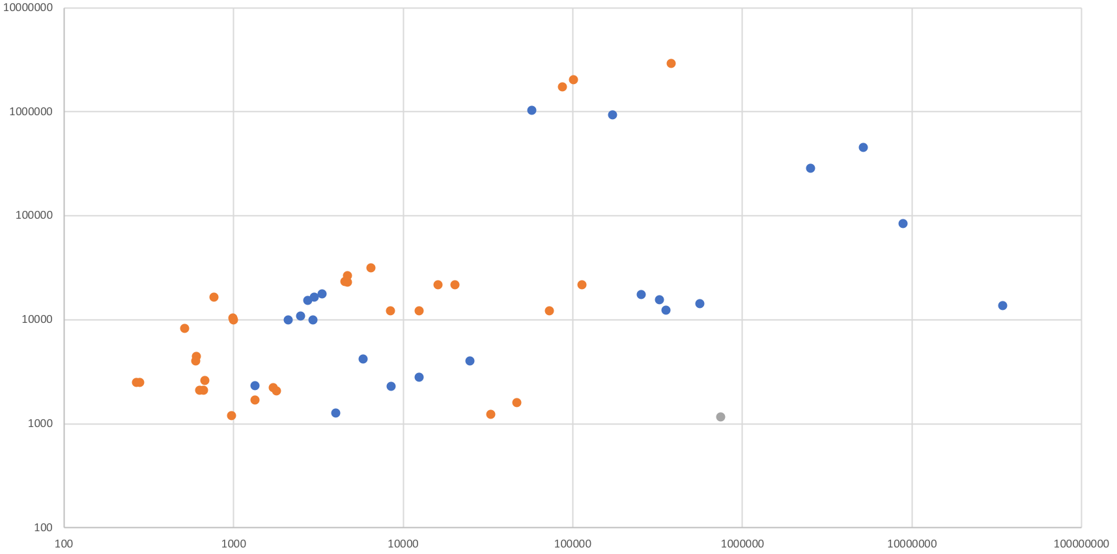
KEM/Encryption (Category 3) Performance by Size
Lattice Codes Other
Public Key + Ciphertext Size (bytes)
KeyGen + Enc Time (1000s of cycles)

Slide 27
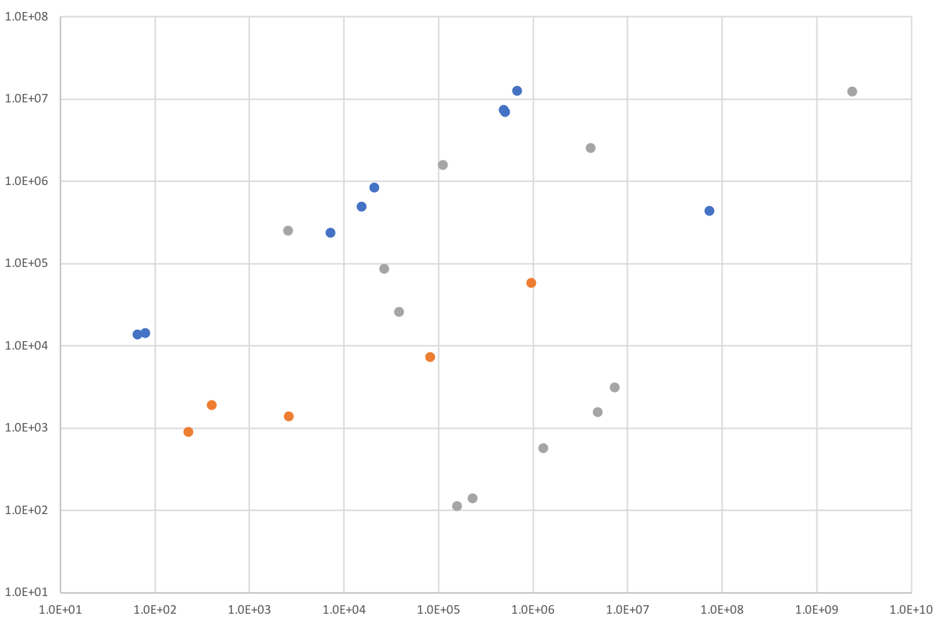
Signatures (Category 1) Performance
Signing Time (1000s of cycles)
Lattice Hash/Symmetric Multivariate
KeyGen Time (1000s of cycles)

Slide 28
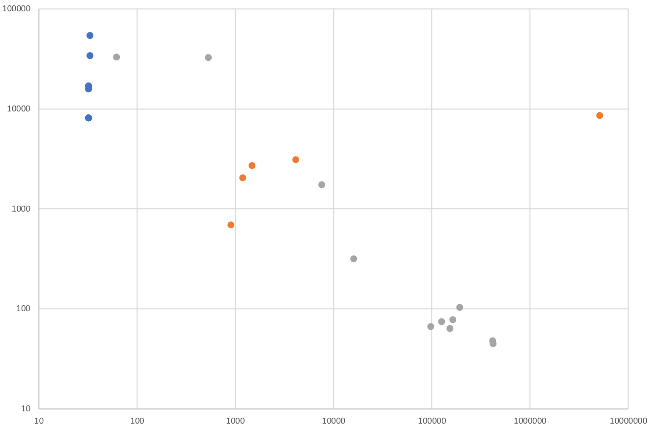
Signature (Category 1) Sizes
Signature Size (bytes)
Lattice Hash/Symmetric Multivariate
Public Key Size (bytes)

Slide 29
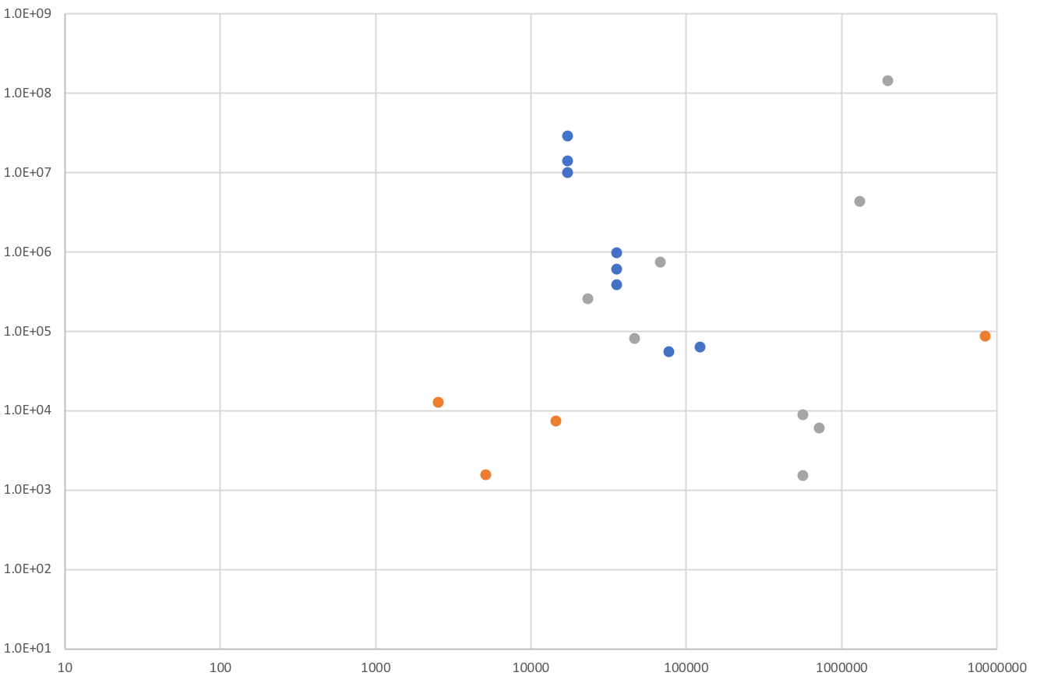
Signatures (Category 3) Performance by Size
Lattice Hash/Symmetric Multivariate
Signing Time (1000s of cycles)
Public Key + Signature Size (bytes)

Slide 30
Discussion and Questions
Since the draft call for proposals was announced, the NIST team has actively interacted with submitters and researchers
The questions include
  APIs to support different ancillary functions
  Using third party libraries
  Submission format
  Decryption failure
  etc.
The topics discussed at pqc-forum@nist.gov include
  Quantum vs. classical security strength
  Security notions (IND-CCA2, IND-CPA, etc.)
  Random number generation
  Key exchange vs. key encapsulation (KEMs)
  Implementation details, (constant-time, etc…..)
  Official comments on submissions
  IP/patent issues
Answers to the common questions and summaries on the major discussion topics are added to the FAQ at www.nist.gov/pqcrypto
Notes:
1000 on the forum

Slide 31
Official Comments
Submit “official comments” on our website using link for each submissions
  Alternatively, post in the pqc-forum with “Official Comment: NameOfSubmission” in the subject line
Comments can be minor (bug fixes) or major (breaks)
  Often are questions, which are answered by submitters
38 submissions have received official comments
  26 submissions have none
  18 submissions have 2 or less
208 official comments so far
  ~60% of these are on 10 submissions.
Notes:
From minor typo or bug fixes to complete breaks.
185 comments gives ~4.5 comment/submission average
(don’t read too much into # of comments per algorithm)

Slide 32
Transition and Migration
NIST will update guidance when PQC standards are available
  A “hybrid mode” has been proposed as a transition/migration step towards PQC
Such a mode combines a classical algorithm with a post-quantum one
Current FIPS 140 validation will only validate the NIST-approved (classical) component
The PQC standardization will only consider the post-quantum component
NIST plans to consider (stateful) hash-based signatures as an early candidates for standardization
  Only for specific applications like code signing
  We hope to hear from industry and implementers on the urgency/impact of hash-based signatures

Slide 33
Standards Organizations
We are aware that many standards organizations and expert groups are working on PQC
  IEEE P1363.3 has standardized some lattice-based schemes
  IETF is taking action in specifying stateful hash-based signatures
  ETSI has released quantum-safe cryptography reports
  EU expert groups PQCRYPTO and SAFEcrypto made recommendations and released reports
  ISO/IEC JTC 1 SC27 has already had a 2 year study period for quantum-resistant cryptography and is developing a standing document (SD)
NIST is interacting and collaborating with these organizations and groups

Slide 34
What’s Next?
2nd NIST PQC Standardization Workshop, Aug 2019
Sometime before then, we will pick a smaller number of submissions that we feel are the most promising
  For these, tweaks are allowed in the 2nd Round
Will be announced on pqc-forum (and our webpage)
If not selected:
  Might be eliminated from the standardization process
  Or might be kept for future consideration, but not in 2nd Round

Slide 35

What does NIST want from you?
Continue to analyze the submissions
  Publish and present your work
Implementations for a variety of platforms
See how these will fit into applications/protocols
  Dig into the details – is there anything different from
  current practice (such as the way to use auxiliary functions)
Participate in the pqc-forum
Send us your questions/feedback:
pqc-comments@nist.gov
Notes:
We really thank you for this!!!

Slide 36

Questions we have…
Does NIST need to provide more guidance on measuring the complexity of quantum attacks?
  Should we specify one or two plausible models of quantum computers?
Or on complexity of classical attacks?
  how to deal with attacks with extremely high memory
How should we handle submissions which are very similar?
  Keep one? Keep both? Merge them? How?
What constitutes unacceptable key sizes or performance?
Notes:
For instance, would they like us to specify one or two plausible models of quantum computers, e.g., qubits in a 2-D or 3-D lattice, with nearest-neighbor Clifford+T gates?) Specifying a model will lead to fights about whether the model is reasonable. But such a model could make it easier for different people to compare their estimates of quantum security.

Slide 37

Summary
Post-quantum crypto standardization will be a long journey
We have seen many complexities, and know more lie ahead
Be prepared to transition to new algorithms in 10 years
We will continue to work in an open and transparent manner with the crypto community for PQC standards
Check out www.nist.gov/pqcrypto
  Sign up for the pqc-forum for announcements & discussion

